Slide 1
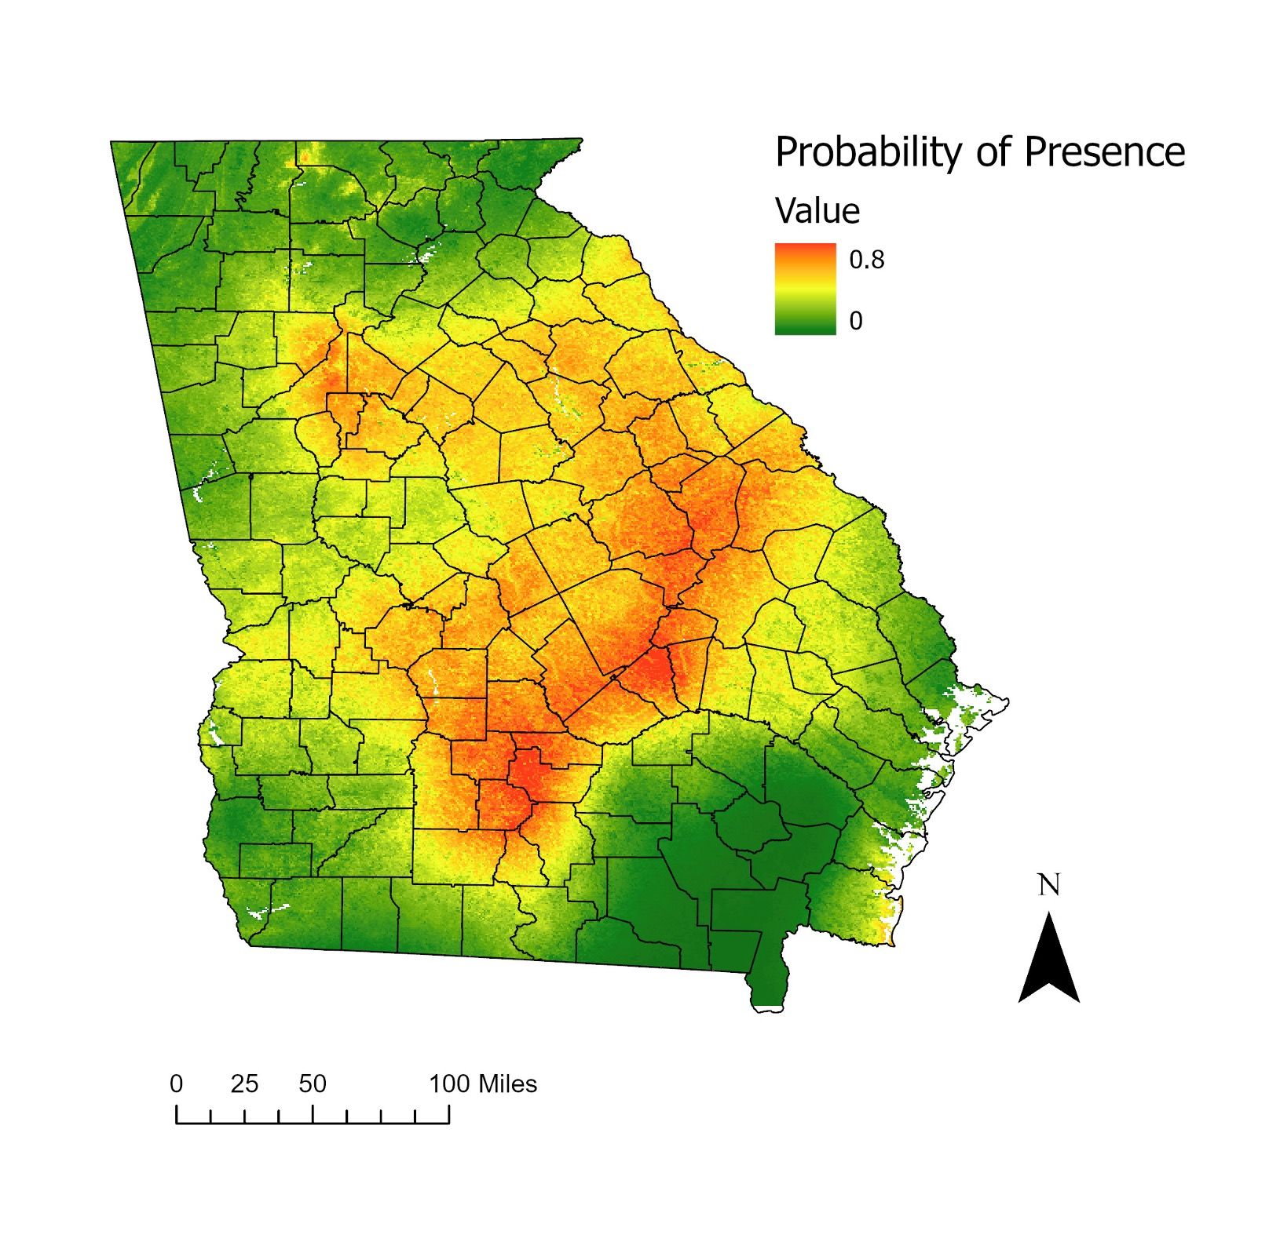

Slide 2
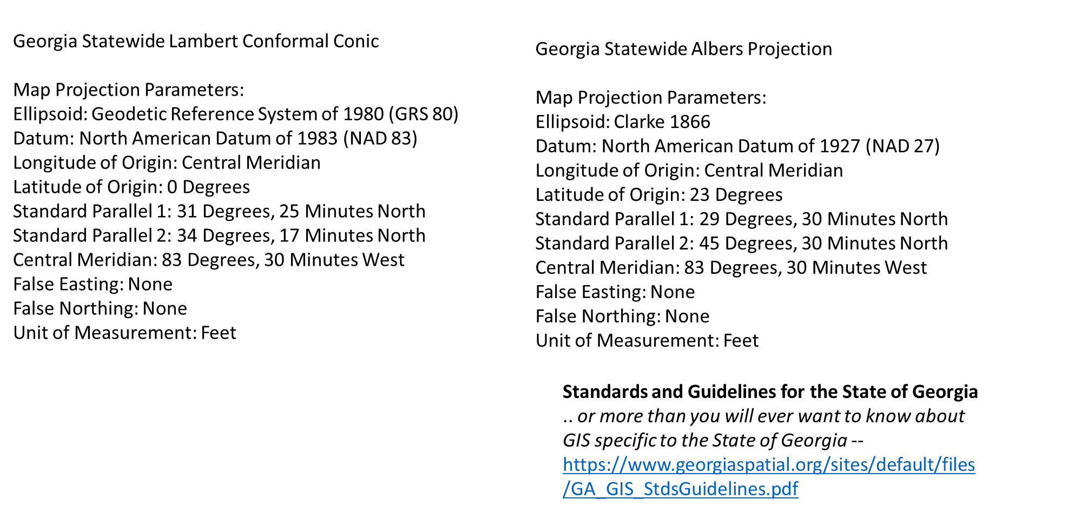
Map Projections Suitable for Georgia

Slide 3
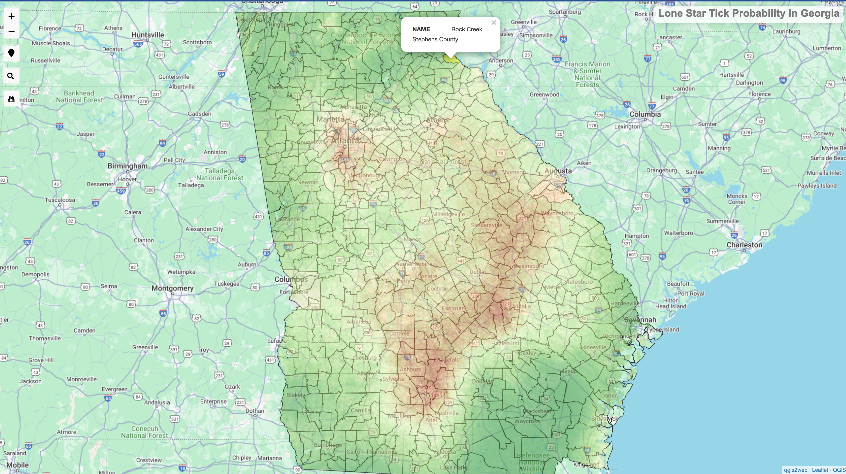

Slide 4
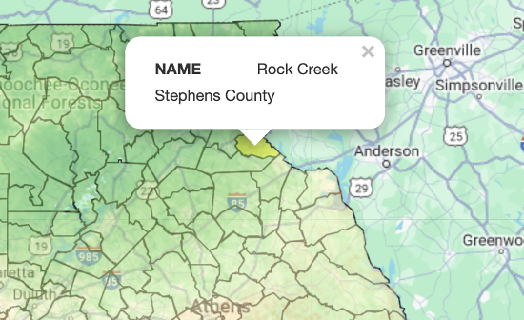
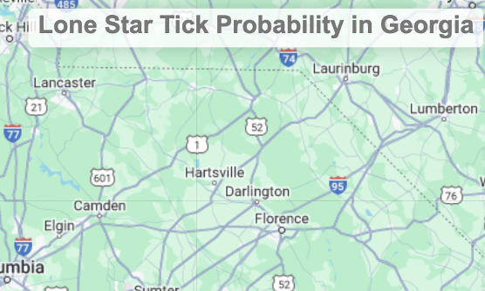
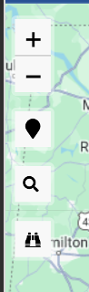
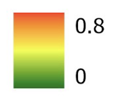


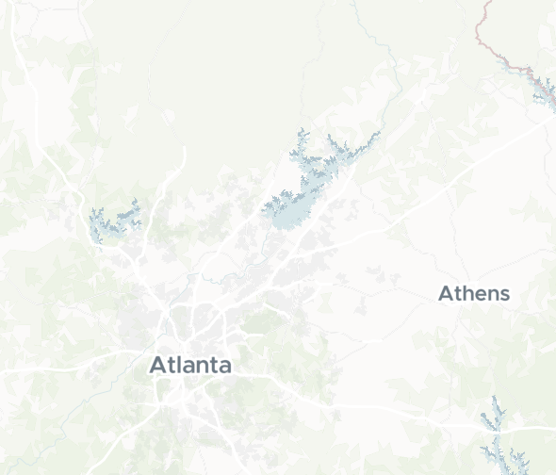
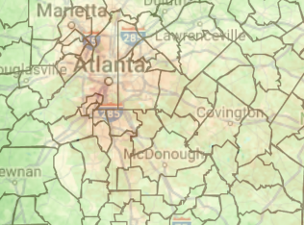
Zoom level should be where the entire state fits within viewing window. Pin zooms to location, eyeglass searches Google Earth, binoculars searches polygon layer.
Probability scale for presence of lone star ticks in Georgia
Red-to-yellow indicates areas with a higher probability of finding lone star ticks. Green indicates the lowest probability. White reflects missing data.
Change title to “Probability scale for presence of lone star ticks in Georgia” and add legend/caption
On polygon rollover – name of area and county is displayed
Add a basemap layer stack that includes Maptiler Data Viz as the default, Google Maps and Google Satellite (in that order) below
Maptiler - Data Vis using Leaflet:
https://docs.maptiler.com/leaflet/examples/vector-tiles-in-leaflet-js/?key=l7oVC7g45zveQUZ4NxXE&mapId=dataviz
This should be the default layer and below the API key I generated
By default, the data layer is transparent, and a slider should be added so the user can control

